Slide 1
Build Joy Summit Day One

Slide 2
Build Excellence Video

Slide 3
VIDEO REFLECTION
What parts of the video struck a chord with you? What are your main takeaways?
What can I start doing that would allow me to maximize my excellence & joy? | What can I stop doing that would allow me to maximize my excellence & joy?
1. | 1.
2. | 2.
3. | 3.
4. | 4.
5. | 5.

Slide 4
LEAD WITH EXCELLENCE
1
2
3
8
4
5
6
7
9
10
Where do you want to live your life?
COMPLACENCE
COMPETENCE
EXCELLENCE

Slide 5
WHY JOY?

Slide 7
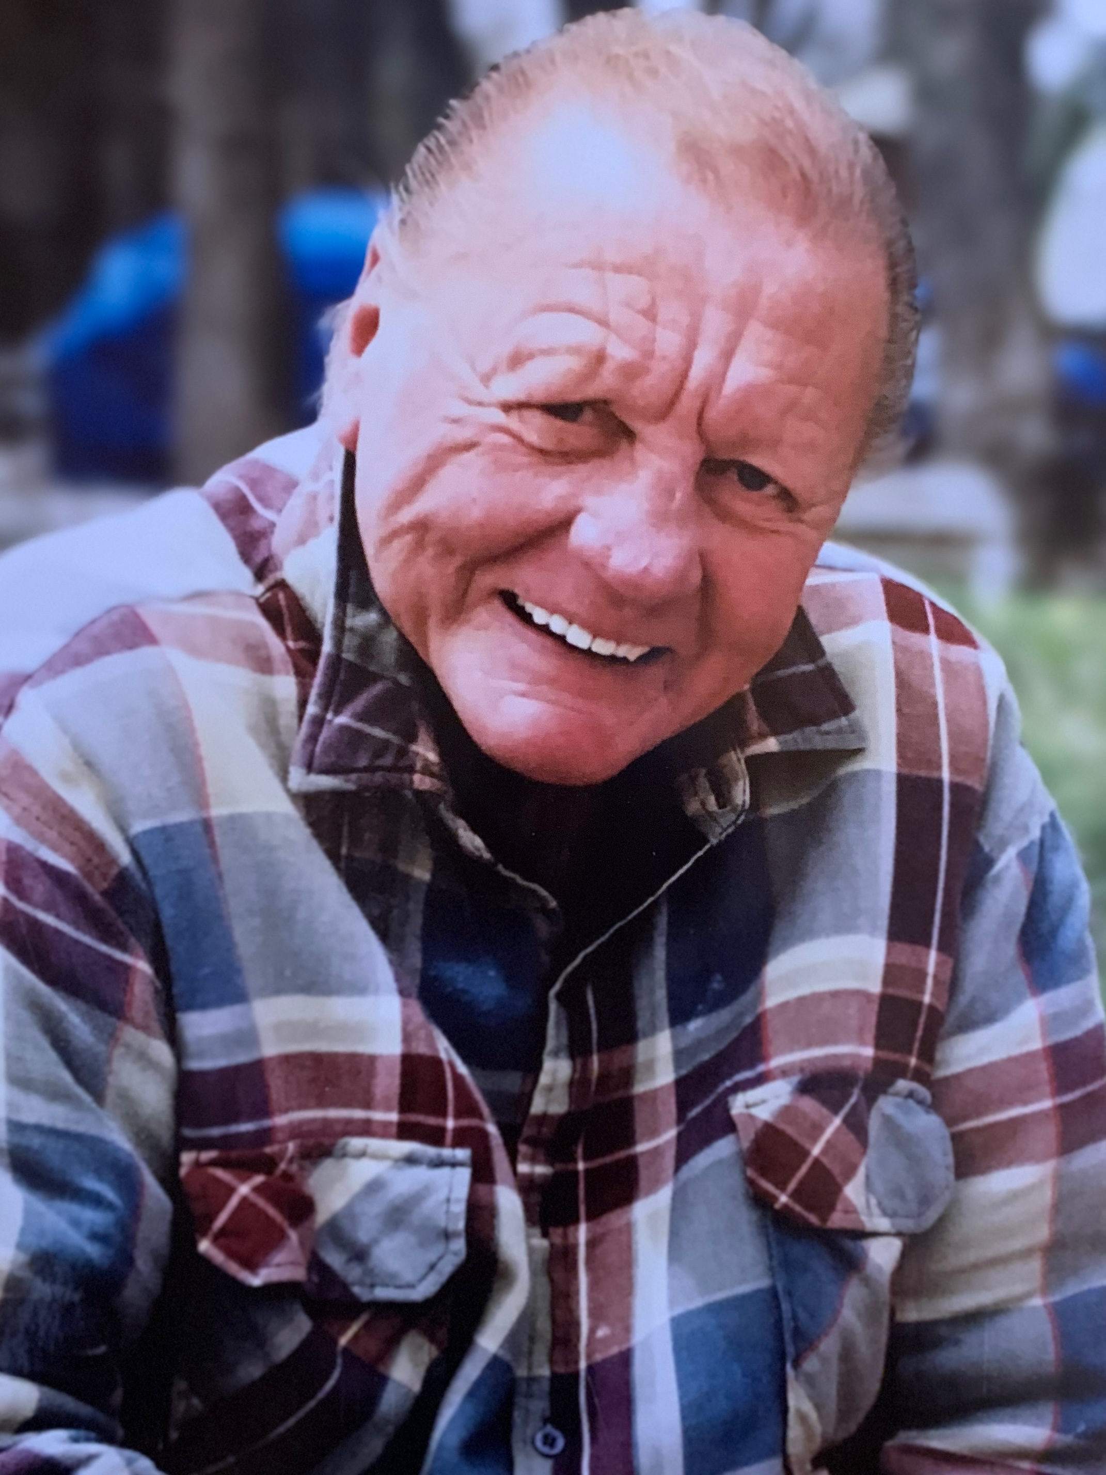

Slide 8
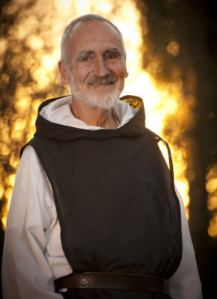

Slide 9
(SUCCESS + WELLBEING) ^{PURPOSE} = JOY

Slide 10
“I wouldn't give a fig for simplicity on this side of complexity, but I would give my life for simplicity on the far side of complexity.”
Oliver Wendell Holmes

Slide 11
(SUCCESS + WELLBEING) ^{PURPOSE} = JOY

Slide 12
Vision Board
& PVT
Scorecard & Monthly Head Check
Difficult
Joy Journal
Habits Training
Groups
HIP
Conversations
Accountability

Slide 13
HALLELUJAH VIDEO

Slide 14
Build Joy Summit Day Two

Slide 15
THINK DIFFERENT

Slide 16
INTRODUCING JOY JUMPS

Slide 17
INTRODUCING JOY JUMPS
What: A Joy Jump is when an individual makes a recognizable advancement towards their joy.
Why: We believe joy is built through the accumulation of small achievements. Whether in the arena of success, wellbeing, or purpose, Joy Jumps are intended to recognize and celebrate the continuous process of building joy. We have created a culture that encourages team members to be present in their life. To not look at a work life balance but recognize you have one life. We are introducing a mechanism for acknowledging these accomplishments.
How: In order to collect Joy Jumps we have created an email address— joyjumps@fbcremodel.com—where we encourage you to submit Joy Jumps that you have recognized in yourself or another team member. Our commitment is to share these Joy Jumps company-wide on a monthly basis.
Our Goal: In 2022, our goal as an organization is to help facilitate and recognize 100 Joy Jumps.

Slide 18
COMPANY VTO
Purpose
10-year target
3- year picture
1- year plan

Slide 19
NEW COMPANY PURPOSE
Build joy for as many people as possible.

Slide 20
NEW 10-YEAR TARGET
We are America's Premiere
Design/Build Firm.
1. $100M Revenue @ 15% Net Income 2. Revolutionized remodel and recognized as such
3. Office’s coast to coast 4. Number 1 in customer experience 5. Every Customer is a Raving Fan for Life 6. We can't tell the difference between work and play
7. Brought Joy to 1,000,000 people

Slide 21
NEW 3-YEAR PICTURE
Revenue
Revenue: $27 M
Contract Sales: $30 M
Profit
Net income: $2.7 M
Measurables
3 Year Measurable: FBC has brought joy to customers, trades and team by
completing 80% of what it looks like

Slide 22
NEW 3-YEAR PICTURE
What does it look like?
1. 60 RPRS 2. Joy Development program is established, and the first class is underway. 3. Core Processes are documented simplified, and 20% efficiencies are gained 4. We won local and national awards 5. Market Research is complete for 4th state location 6. Broad client services are offered including internal trades, pop- tops, additions and whole house remodel in 5 weeks 7. Colorado expanded to 2 or 3 additional cities (NORCO,SOCO, Bolder or Mountain Town)
8. Clearly defined and brought JOY to our customers, trades and team 9. Client Segments are profitable, efficient, and well-documented
10. Lead flow consistent and predictable 11. Project Team Circles predictable, running, simplified and repeatable 12. Luxury client remodel experience delivered 13. Internal Trades 14. Brand elevated to being synonymous with premier remodel
15. Production Team Driving E-Trucks

Slide 23
NEW 1- YEAR PLAN
Revenue
Revenue: $19.25 M
Contract Sales: $21 M
Profit
Net income: $1.54 M
Measurables
1 Year Measurable: 100 Joy Jumps Recognized

Slide 24
NEW 1- YEAR PLAN
Goals for the Year
1. 8 RPRS
2. FBC Leadership Program Developed
3. "The FBC Way" is FBC Mental is documented, simplified and followed by all
4. EOS is rolled out in local markets and departments
5. Systems and Processes generating a production team that can't tell if it's working or playing
6. By Q4 - 75% bathrooms and kitchens are completed by internal trades in CO
7. Addition and pop-tops - People, tools and process established

Slide 25
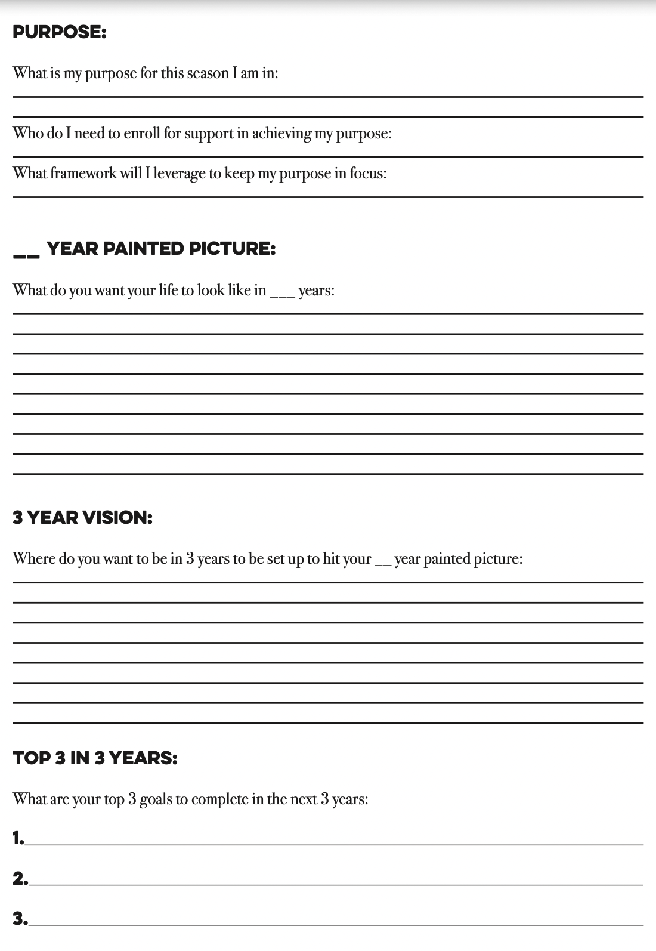
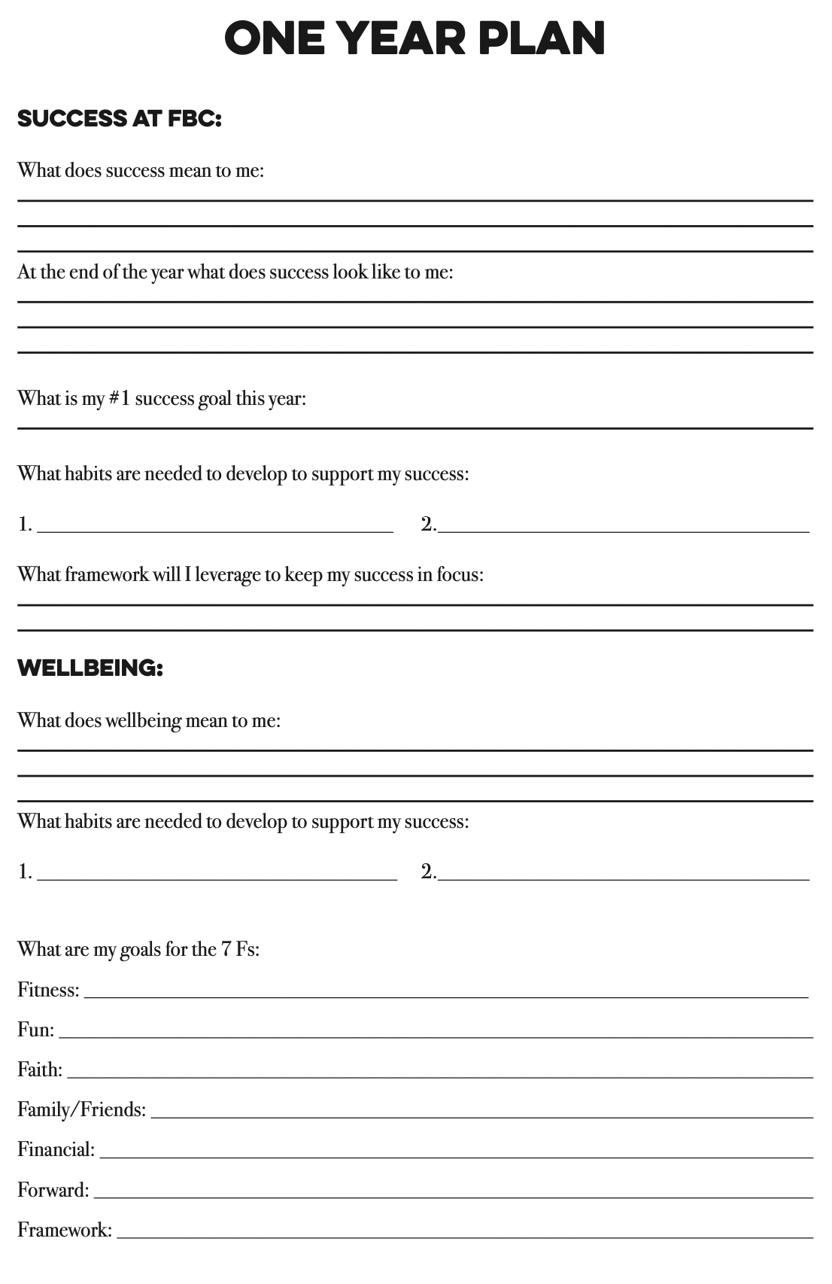
PERSONAL VISION TRACKER

Slide 26
PURPOSE EXERCISE
Dreams
Passions
Strengths
TALENTS
VALUES
INVESTMENTS
What were your childhood dreams?
Who were your heroes?
Who are your heroes?
What makes you come to life?
These are things that light your soul on fire.
What are your natural strengths?
What comes easy to you?
Where do you add the most value?
What issues do you solve in the workplace?
At home? With friends?
How will you measure the success of your life?
What are your values and priorities?
Where do you spend your free time?
What do you put your money towards?
Is there a volunteer service you are invested in?

Slide 27
PURPOSE EXERCISE
Question to consider when drafting your purpose statement:
1. What do I do? What is my contribution?
2. What impact do I want to make?
Example: To empower others to become their best selves so that they can excel at their life’s work.

Slide 28
10-YEAR PAINTED PICTURE

Slide 29
3-YEAR VISION

Slide 30
1-YEAR PLAN: WELLBEING

Slide 31
1-YEAR PLAN: SUCCESS

Slide 32
JOY JOURNALS

Slide 33
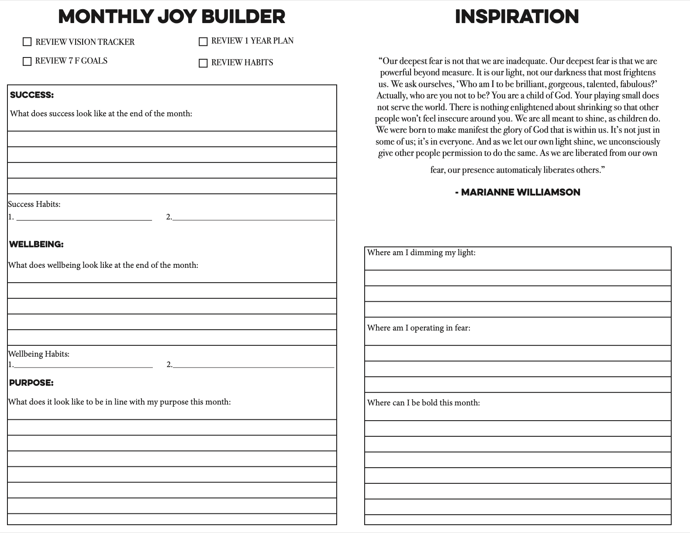
MONTHLY

Slide 34
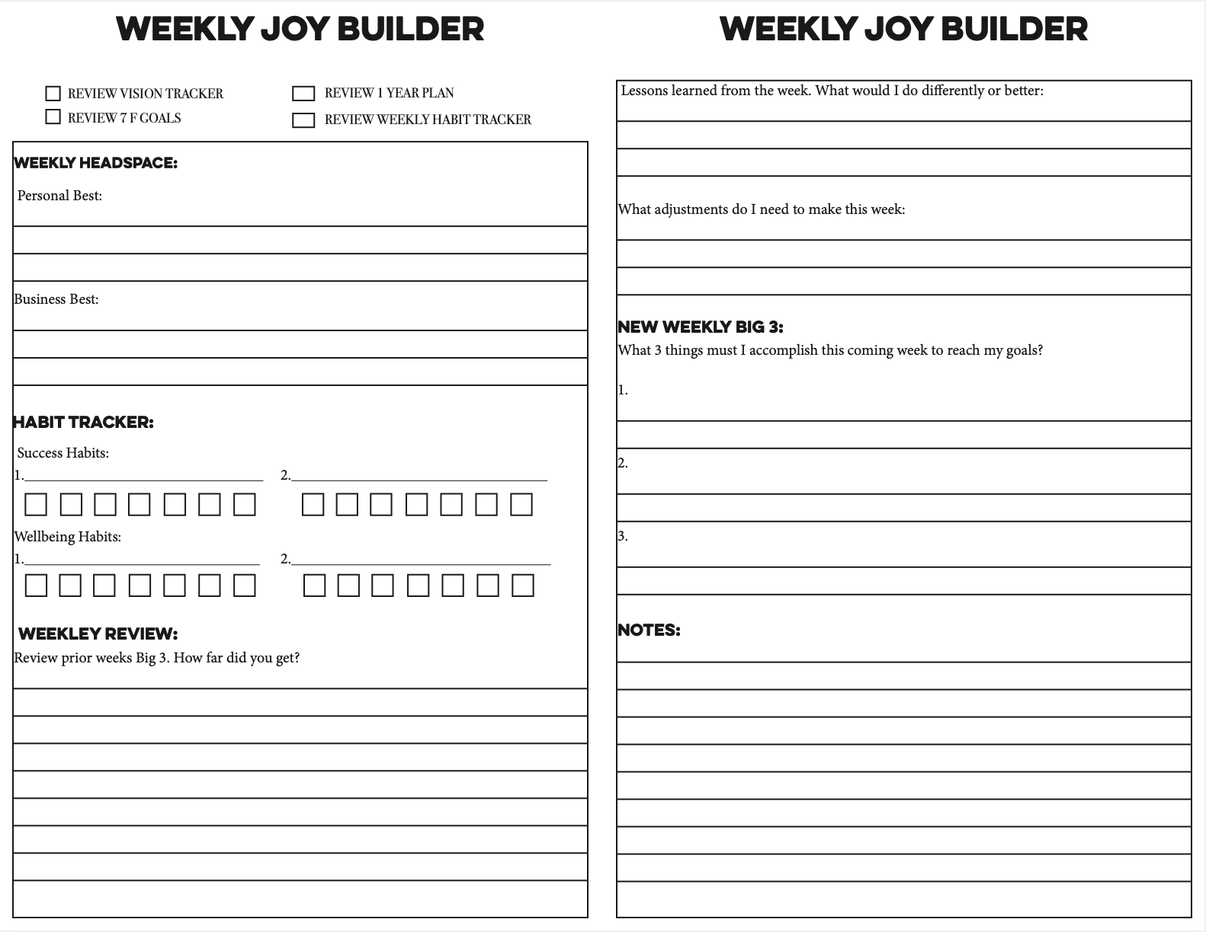
WEEKLY

Slide 35
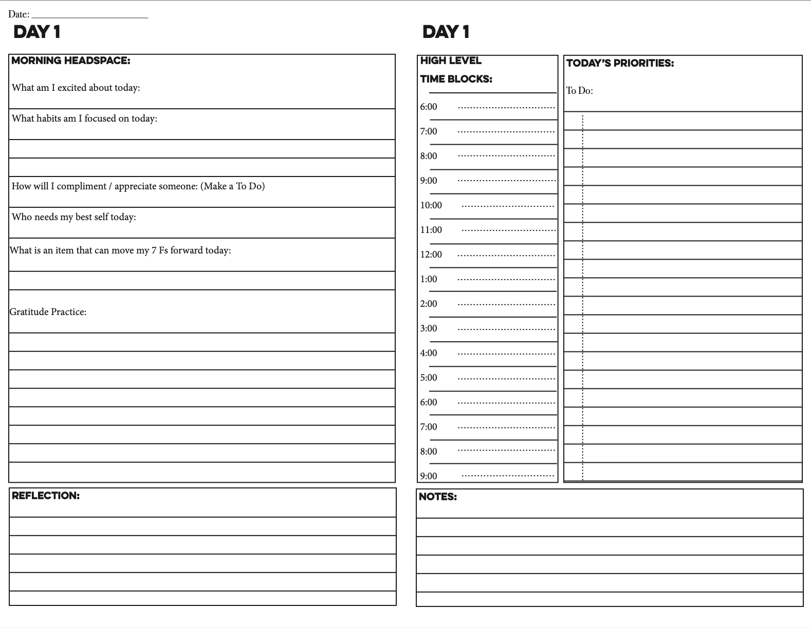
DAILY

Slide 36
LEADERSHIP VIDEO

